Slide 1

DATA STRUCTURES USING C
MINI PROJECT ON :
SCHOOL MANAGEMENT SYSTEM
PRESENTED BY GROUP 7
Udayshankar
Vaibhav
Sriniketan
Vikas

Slide 2

What is a school management system ?
A School Management System is a software solution designed to streamline and manage the day-to-day administrative tasks of a school. It helps in maintaining, organizing, and retrieving student data efficiently.

Slide 3



Chatbot-Based Interface:
Instead of using typical menus, we made a chatbot-style interface that is much more easier to work with
What have we done?
Core Functionalities Implemented:
Add Student Details
Search by Roll Number
Count of Students
Search by Course
We have developed a School Management System using C programming language, where all operations are performed via a text-based chatbot interface. The system allows users (like school staff) to interact with it using simple commands.
Uses of the Project:
1. Student Information Management
2. Fast Search and Retrieval
3. Course-wise Student Filtering
4. Total Student Count
5. Chatbot-Based Interaction

Slide 4
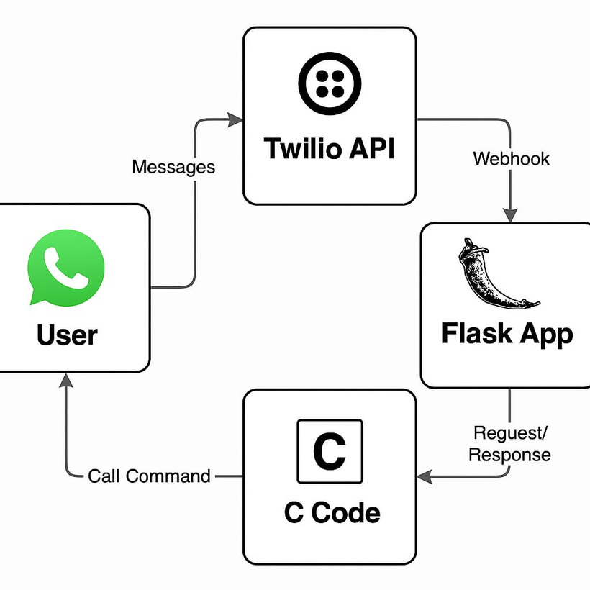
Technologies used:
Flask: Web server to handle HTTP requests
Twilio: To send/receive WhatsApp messages
Ngrok: To expose your Flask app to the internet (local → public)
C CODE: For the program implementation

Slide 5
C Code Implemented using DS:
Code: https://github.com/Vaibhav-029/DS-code-mini-project/blob/main/Code

Slide 6
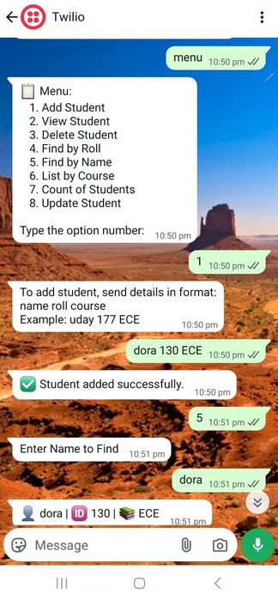
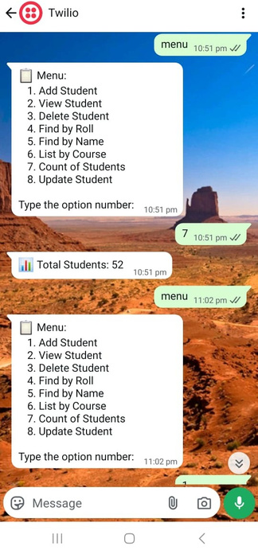
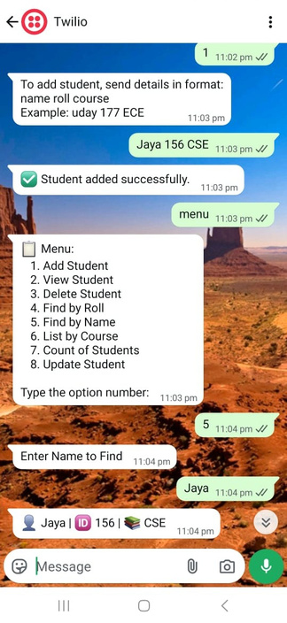
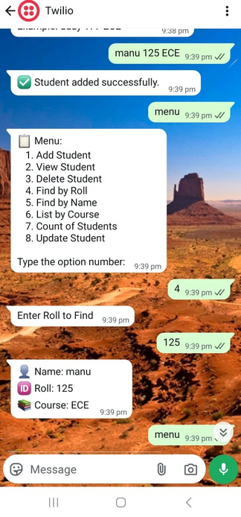
Layout and Execution :-

Slide 7
Conclusion:
We have developed a basic School Management System using C programming language and data structures.
🔹 The system can:
Add student details
Search by roll number or name
List students by course
Delete or update records
Show total number of students
What We Learned
Practical use of structs, arrays, and functions
How to design a menu/chatbot-like interface
Importance of modular code and user-friendly interaction

Slide 8
Thank you very much!

